Slide 1
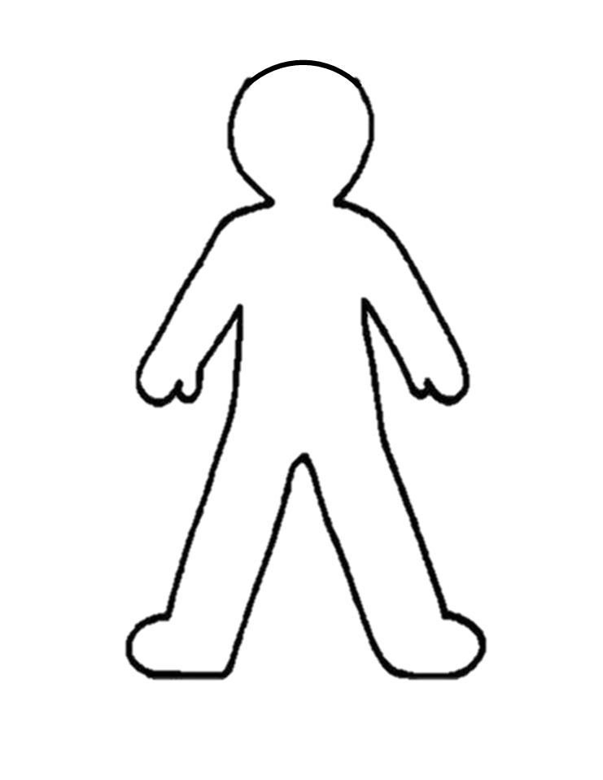
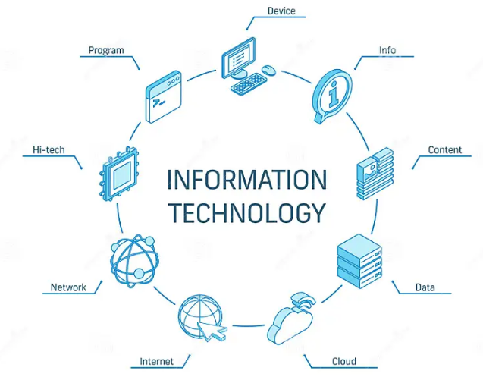
I am an Early Years Computer Scientist because..
To be able to understand what a computer keyboard is and recognising some letters and numbers.
To know that a mouse can be used to click, drag and create simple drawings.
I can recognising and identifying familiar letters and numbers on a keyboard.
I am developing basic mouse skills such as moving and clicking.
I can use logical reasoning to understand simple instructions and predict the outcome.
To know that being able to follow and give simple instructions is important in computing.
To understand that it is important for instructions to be in the right order.
To understand why a set of instructions may have gone wrong.
To know that sorting objects into various categories can help you locate information.
To know that using yes/no questions to find an answer is a branching database.
I can use a simple online paint tool to create digital art.
I can represent data through physical pictograms.
I recognise that a range of technology is used for different purposes.
I am learning to log in and log out.
I can safely use and explore a variety of materials.

Slide 2
I am an Year 1 Computer Scientist because..
To know that "log in and log out" means to begin and end a connection with a computer.
To know that a computer and mouse can be used to click, drag, fill and select and also add backgrounds, text, layers, shapes and clip art..
I am learning how to operate a camera or tablet to take photos and videos.
I am learning where keys are located on the keyboard.
I am learning that decomposition means breaking a problem down into smaller parts.
I can follow a basic set of instructions.
I can assemble instructions into a simple algorithm.
To understand that an algorithm is when instructions are put in an exact order.
To understand that decomposition means breaking a problem into manageable chunks and that it is important in computing.
To know that we call errors in an algorithm 'bugs' and fixing these 'debugging'.
To know how that charts and pictograms can be created using a computer.
To understand that a branching database is a way of classifying a group of objects
I can take and editing photographs.
I can use mouse control by dragging, clicking and resizing images to create different effects
I can use software to explore and create pictograms and branching databases.
I can log in and out and saving work on my own account.
I understand what to do when using the internet to search for images.
I understand what to do if I come across something online that worries me or makes me feel uncomfortable.

Slide 3
I am an Year 2 Computer Scientist because..
To know the difference between a desktop and laptop computer.
To know that computers often work together.
To know that touch typing is the fastest way to type
I am using greater control when taking photos with cameras, tablets or computers.
I am developing confidence with the keyboard and the basics of touch typing.
I can articulating what decomposition is.
I can explaining what an algorithm is and follow an algorithm.
I can incorporate loops within algorithms
To know that loops in programming are where you set a certain instruction (or instructions) to be repeated multiple times.
To know that abstraction is the removing of unnecessary detail to help solve a problem.
To understand that you can enter simple data into a spreadsheet.
To understand what steps you need to take to create an algorithm.
To know what data to use to answer certain questions.
I am developing word processing skills, including altering text, copying and pasting and using keyboard shortcuts.
I can use word processing software to type and reformat text.
I can collect and input data into a spreadsheet.
I am learning how to create a strong password.
I can identify whether information is safe or unsafe to be shared online.

Slide 4
I am a Year 3 Computer Scientist because..
To know what a tablet is and how it is different from a laptop/desktop computer.
To understand what a network is and how a school network might be organised.
I can understanding what the different components of a computer do and how they work together.
I can use decomposition to explain the parts of a laptop computer.
I can explain the purpose of an algorithm. Forming algorithms independently
To understand how to use loops to improve programming.
To understand how decomposition is used in programming
To know that a database is a collection of data stored in a logical, structured and orderly manner.
To know that computer databases can be useful for sorting and filtering data.
I recognise that different information is shared online including facts, beliefs and opinions.
I am learning how to identify reliable information when searching online.
I am learning how to stay safe on social media.
I can consider the impact technology can have on mood.
I can take photographs and record video to tell a story.
I can Sort and filter databases to easily retrieve information.
I can create and interpret charts and graphs to understand data.

Slide 5
I am a Year 4 Computer Scientist because..
To understand that software can be used collaboratively online to work as a team.
I can use tablets or digital cameras to film
I can use decomposition to understand the purpose of a script of code.
I can identify patterns through unplugged activities. Using past experiences to help solve new problems.
I can use abstraction to identify the important parts when completing both plugged and unplugged activities.
To understand that a variable is a value that can change (depending on conditions) and know that you can create them in Scratch.
To know what a conditional statement is in programming.
To know that computers can use different forms of input to sense the world around them so that they can record and respond to data. This is called ‘sensor data’.
I can recognise that information on the internet might not be true or correct and that some sources are more trustworthy than others.
I can reflect on the positives and negatives of time spent online.
I can identify respectful and disrespectful online behaviour.
I can use software to work collaboratively with others.
I can record data in a spreadsheet independently.
I can sort data in a spreadsheet to compare using the ‘sort by…’ option.

Slide 6
I am a Year 5 Computer Scientist because..
To know how search engines work.
To understand what copyright is.
I am learning the difference between ROM and RAM.
I can recognising how the size of RAM affects the processing of data.
I can write more complex algorithms for a purpose.
I can use a range of programming commands and use repetition within a program.
To know that a Micro:bit is a programmable device.
To know that Micro:bit uses a block coding language similar to Scratch.
To understand that RAM is Random Access Memory and acts as the computer’s working memory..
I can use the video editing software to animate.
I can identify ways to improve and edit programs, videos, images etc.
I can Identify possible dangers online and am learning how to stay safe.
I can evaluate the pros and cons of online communication.
I am learning what to do if I experience bullying online.
I can safely use and explore a variety of materials.

Slide 7
I am a Year 6 Computer Scientist because..
To understand the importance of having a secure password and what "brute force hacking" is..
I can understand and identifying barcodes, QR codes and RFID and can identify devices and applications that can scan or read barcodes, QR codes and RFID.
I can understand how corruption can happen within data during transfer (for example when downloading, installing, copying and updating files).
I can debug quickly and effectively to make a program more efficient.
I can use and adapt nested loops.
I can use the language Python when programming.
To know that there are text-based programming languages such as Logo and Python.
To know that nested loops are loops inside of loops..
To know that data contained within barcodes and QR codes can be used by computers.
To know that data is often encrypted so that even if it is stolen it is not useful to the thief.
To know that data can become corrupted within a network but this is less likely to happen
I can use search and word processing skills to create a presentation.
I can create and editi videos, adding multiple elements: music, voiceover, sound, text and transitions
I understand how barcodes, QR codes and RFID work.
I can create formulas and sort data within spreadsheets.
I am learning about the positive and negative impacts of sharing online.
I understand the importance of secure passwords and how to create them.
I recognise that updated software can help to prevent data corruption and hacking.

